Slide 1
EtherChannel Concepts and Configuration
Randy James
Department Head, BCIT MA Learning & Technology
Date: July 2013

Slide 2
The ability to bundle ports together to achieve higher bandwidth is described as link aggregation. Aggregating ports on Ethernet switches is referenced under EtherChannel configuration and operation.

Slide 3
Example:
Distribution switches use EtherChannel bundles to connect to the campus core

Slide 4
“EtherChannel simplifiers design improves operation when multiple physical interfaces are needed to interconnect switches”.

Slide 5


Spanning-tree operation
With two redundant links spanning-tree will block on one port to prevent loops
EtherChannel allows spanning-tree to treat the two physical links as one logical port and thus both ports can operate in full forwarding mode

Slide 6
EtherChannel operation
If a physical link in the group goes down the EtherChannel only loses the bandwidth that link supplied. If the physical link comes back up it is dynamically added back into the EtherChannel.
Spanning-tree treats the EtherChannel bundle as a single logical switchport and adjusts the spanning-tree cost to reflect the increased bandwidth.
The EtherChannel may or may not be configured to trunk depending on the needed design

Slide 7
EtherChannel terminology
We aggregate multiple physical Ethernet ports together using a channel-group command. A single logical interface is created called a port-channel.
On the Cisco Catalyst switches we can aggregate up to eight 10/100 ports together creating a port-channel with 800 Mbps bandwidth (literature may indicate 1600 Mbps as the bundle has full-duplex operation).
If available we can aggregate up to eight gigabit ports
All ports in a bundle must have identical operational status and configuration

Slide 8
EtherChannel load-balancing
EtherChannel loads shares (load balances) across all the physical ports in the EtherChannel group.
The default method of load sharing uses the source MAC in frames. Frames from different sources are sent out different ports but all frames from one source will be sent out the same port.
We can change the default load-balancing via a global command port-channel load-balance [dst-ip | dst-mac | src-dst-ip | src-dst-mac | src-ip | src-mac]

Slide 9
An important concept is that Ethernet frames are “not fragmented” or split apart on EtherChannel – an Ethernet frame is sent out one selected port and traverses the link intact.

Slide 10
Channeling protocols
Catalyst switches can leverage a protocol to dynamically establish and maintain the EtherChannel bundle.
The channel-group mode command allows you to decide if the EtherChannel group uses Port aggregation Protocol (PAgP), Link Aggregation Protocol (LACP), or to simply force the interface to channel without PAgP or LACP.
Forcing interfaces to channel may create problems if any interfaces have dissimilar configurations.

Slide 11
Port Aggregation Protocol
PAgP allows the switches to learn the capabilities of each interface assigned to an EtherChannel bundle and reliably activates interfaces of similar configuration to form a port-channel.
PAgP transmits and receives messages on all interfaces in the EtherChannel bundle and restricts the PAgP traffic to the native VLAN if the ports are in trunking mode.
LACP is similar in operation to PAgP and standards based while PAgP is Cisco proprietary.

Slide 12
Other local link protocols such as DTP, VTP, CDP, and STP still transmit and receive frames over a port-channel. STP only sends frames out the first interface in the port-channel and views the port-channel as a single physical port

Slide 13
Spanning-tree Costs
Spanning-tree reflects the increased bandwidth provided by EtherChannel.
The default cost for a 100 Mbps link is 19 and if a port-channel is created that has only two 100 Mbps links the spanning-tree cost will be 9.
A port-channel with six or more 100 Mbps physical ports will have an STP cost of 5.
STP costs for port-channels vary according to how many ports are assigned to the bundle, not how many are active within the bundle.

Slide 14
EtherChannel configuration
Switch(config)# interface range fa0/1 – 4 {we can use the range or single interface}
Switch(config-if)# channel-group [1 – 6] mode [auto | desirable | on | active | passive]
The number of channel groups is platform dependent.
Auto and desirable modes activate PAgP.
Active and passive activate LACP.
Mode on forces the interface to channel without PAgP or LACP.

Slide 15
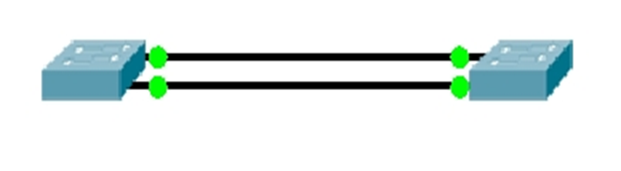
EtherChannel verification
If we wish to view the operation we use the term “etherchannel”.
Switch# show interface etherchannel
Switch# show etherchannel [summary | load balance | port-channel]
The following slides provide insight into an EtherChannel setup between two switches.

Slide 16
Switch0# show etherchannel
Channel-group listing:
----------------------
Group: 1
----------
Group state = L2
Ports: 2 Maxports = 8
Port-channels: 1 Max Portchannels = 1
Protocol: PAGP
The channel has two ports and PAgP was used to create.
It is a layer-2 etherchannel.

Slide 17
Switch0# show etherchannel summary
Flags: D - down P - in port-channel
I - stand-alone s - suspended
H - Hot-standby (LACP only)
R - Layer3 S - Layer2
U - in use f - failed to allocate aggregator
u - unsuitable for bundling
w - waiting to be aggregated
d - default port
Number of channel-groups in use: 1
Number of aggregators: 1
Group Port-channel Protocol Ports
1 Po1(SU) PAgP Fa0/1(P) Fa0/2(P)
The summary provides status of the ports and the port-channel itself.

Slide 18
Switch0# show etherchannel load-balance
EtherChannel Load-Balancing Operational State (src-mac):
Non-IP: Source MAC address
IPv4: Source MAC address
IPv6: Source MAC address
Traffic to be transmitted out the port-channel is distributed via the source MAC in the frame header.

Slide 19
Switch0# show etherchannel port-channel
Port-channel: Po1
------------
Age of the Port-channel = 00d:01h:22m:29s
Logical slot/port = 2/1 Number of ports = 2
GC = 0x00000000 HotStandBy port = null
Port state = Port-channel
Protocol = PAGP
Port Security = Disabled
Ports in the Port-channel:
Index Load Port EC state No of bits
------+------+------+------------------+-----------
0 00 Fa0/2 Desirable-Sl 0
0 00 Fa0/1 Desirable-Sl 0
Time since last port bundled: 00d:00h:37m:14s Fa0/1

Slide 20
EtherChannel verification continued
The previous slide provided the output from the show etherchannel port-channel command. PAgP messages are carried on Fa01 – hence the highlight.
Another command with considerable output is:
Switch# show interface etherchannel
All of these commands are useful to troubleshoot EtherChannel operation. When troubleshooting always begin by verifying the physical ports all have the same operational parameters and do this at both ends of the EtherChannel. Next verify channel-group settings again at both ends of the EtherChannel. Do not make assumptions – verify and test.

Slide 21
This wraps up the introduction to EtherChannel. Please review the accompanying notes for some added detail.

Slide 22
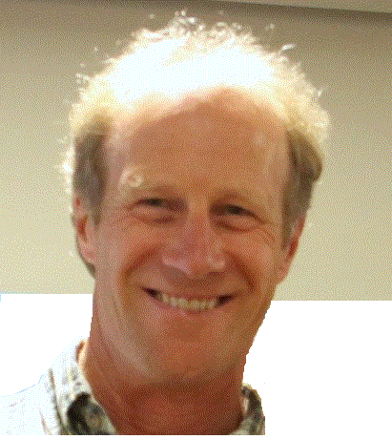
I urge you to take some time and discover EtherChannel.
Randy

